Slide 1

GROUP 2 EDA PROJECT TITLE: PR CONSULTATION
PR CONSULTATION
GROUP MEMBER
Monisola
Olayinka
Nathaniel
Geoffrey
August 2022

Slide 2

EXECUTIVE SUMMARY
Dataset is Quality of life in a country comparison - With a total of 36 factors included in the overall index calculation, which was then divided into 7 subject areas here. The best achievable value in each division is 100.
Data applies primarily to residents who also receive their income and pay taxes in their respective countries.
Dataset Reference
https://www.kaggle.com/datasets/shivamsingh0194/quality-of-life-in-a-country-comparison?select=Quality+of+life+in+a+country+comparison.csv
https://www.worlddata.info/quality-of-life.php?expats=0&stability=15&rights=20&health=15&safety=10&climate=15&costs=15&popularity=10#ranges
The analysis was carried out for a PR Agency. This is necessitated due to the more stringent entry qualifications for the more popular countries a lot of people relocate to.
Explorative Data Analysis was carried out to make recommendations on countries to relocate to based on certain factors that add up to better Quality of Life.
Dataset Description: It has 137 rows and 12 columns all with unique values.
Descriptive Questions
Q1: what are the top 10 countries with the highest Quality of Life? Which is the highest one?
Q2: what are the lower 10 countries with the lowest Quality of Life (QoL)? Which is the lowest one?
Q3: Ratio of Quality-of-Life Range per Continent.
Relation Questions
Q4: Do countries with better stability in politics and economics have a higher Quality of Life?
Q5: Do countries with higher popularity have a higher Quality of Life (QoL)?
Q6: finally, is there a relationship between Climate, Rights (Civil, Legal & Human), and quality of life (QoL)?

Slide 3
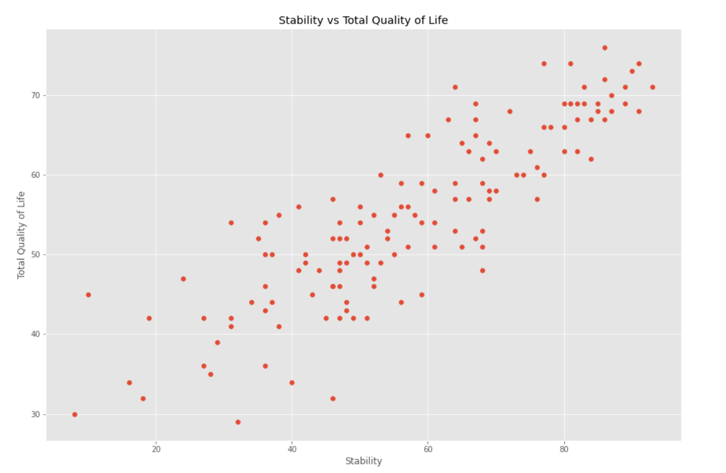
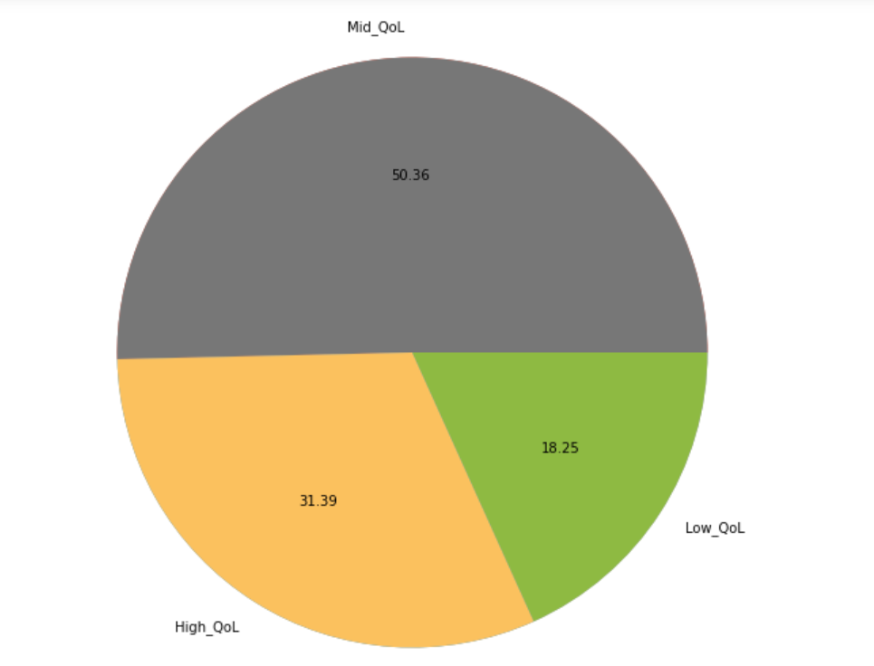
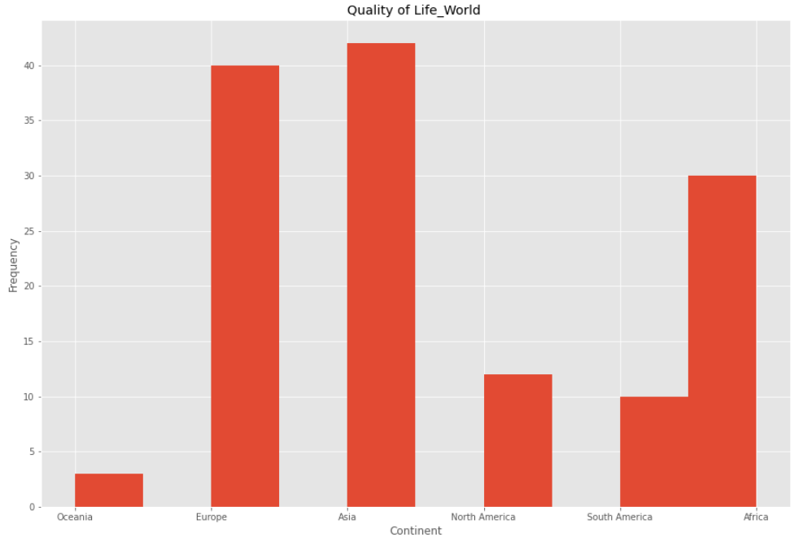
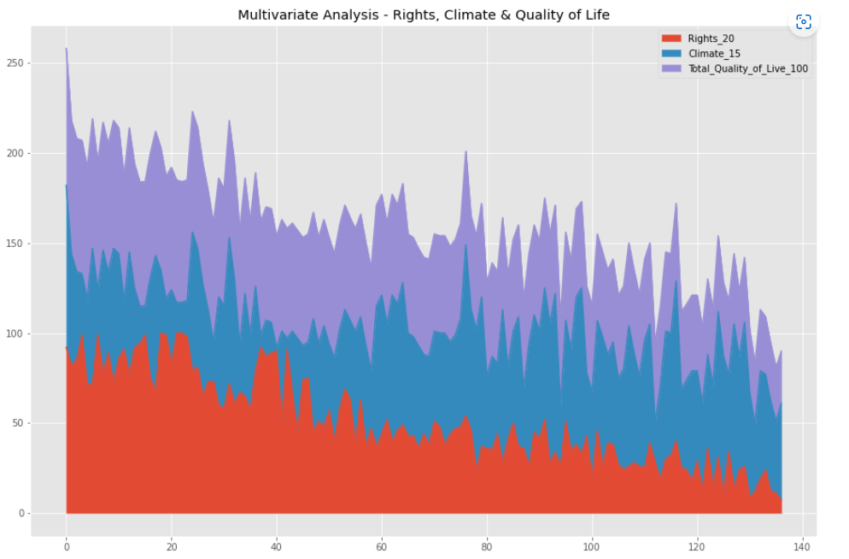
VISUALS
2
1
3
4

Slide 4
CONCLUSION
Questions & Insights
Visual 1 (Scatter plot) – Answers (Question 3) “Do countries with better stability in politics and economics have a higher Quality of Life?” Yes, they do. The relationship between Stability and Quality of Life. This shows that there is a relationship between Citizens’ Safety and Quality of Life. Our Scatter plot shows that Countries with higher safety have a higher quality of life, as the result tends towards the right.
Visual 2 (Pie Plot) – The ratio of Quality-of-Life Range per Continent. Clarifies what continent has the most count for High-level Quality of Life.
Visual 3 (Histogram) – This shows the frequency of the Continent in the dataset. Clarifies what continent appears the most in our data set. This shows that the Continent with the highest frequencies has the highest Quality of Life in the world.
Visual 4 (Area Plot) – Answers (Question 6) “is there a relationship between Climate, Rights (Civil, Legal & Human), and quality of life (QoL)?” Yes, there is. The chart shows that if Climate and Rights values are high the Total Quality of Life is also high.
Our analysis revealed
The top ten countries to be (Australia, San Marino, Hong Kong, Switzerland, Macao, Malta, Luxembourg, Bermuda, Singapore, and Spain) which are fairly evenly distributed between Asia & Europe.
The bottom ten countries to be (Zimbabwe, Angola, Mozambique, Afghanistan, Iraq, Cameroon, Nigeria, Chad, Sudan, and Congo) most of which can be found in Africa.
Country with higher Stability Index have higher Quality of Life.
Further Analysis to reveal the top 10 countries by health for purpose of Health & Well-being tourism.

